Slide 1

PROPOSITIONAL LOGIC
Syntactic Approach

Slide 2

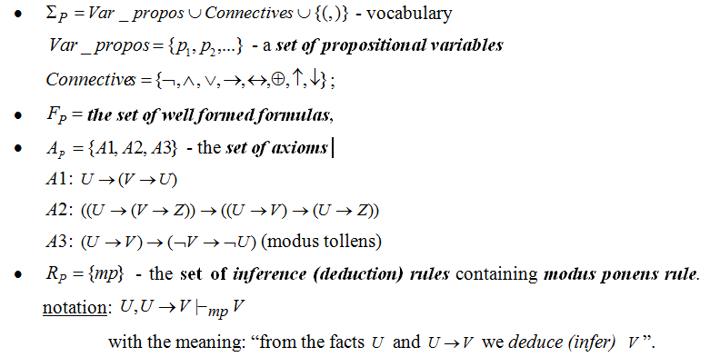
AXIOMATIC (FORMAL) SYSTEM:

Slide 3
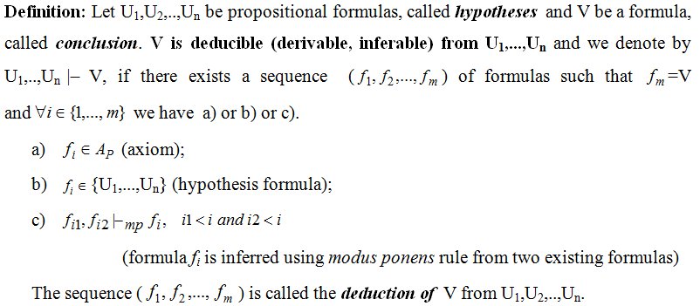
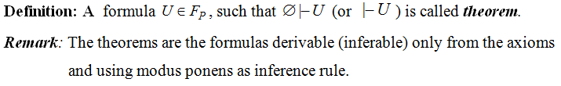
DEDUCTION

Slide 4
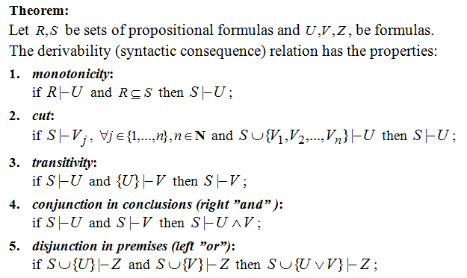
PROPERTIES OF DERIVABILITY RELATION

Slide 5
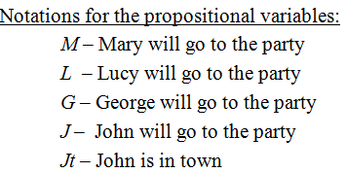
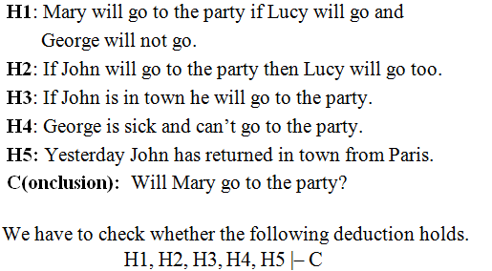
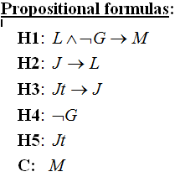
EXAMPLE 1 OF REASONING MODELING: PARTY

Slide 6
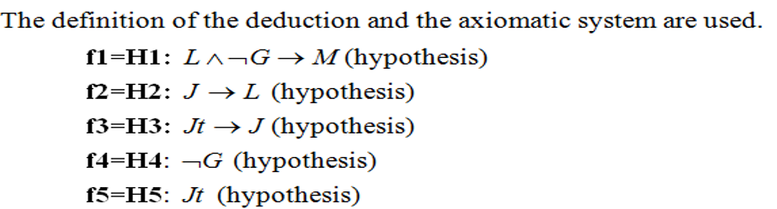




Slide 7
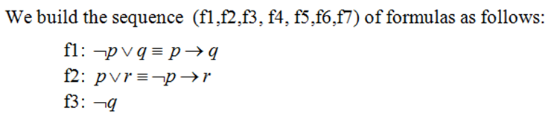

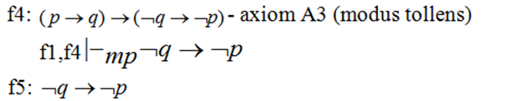
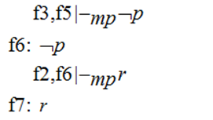
EXAMPLE 2

Slide 8
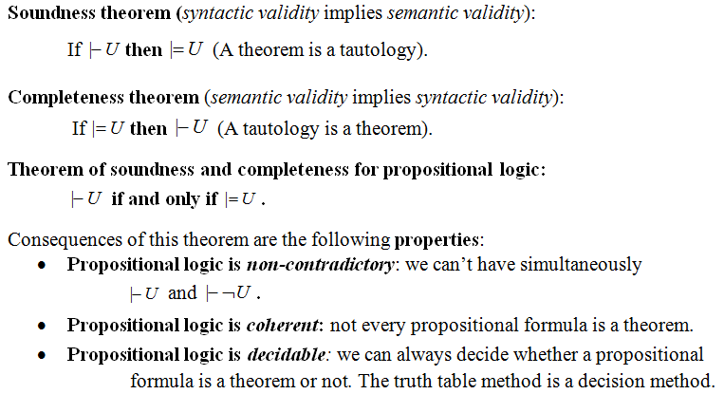
PROPERTIES OF PROPOSITIONAL LOGIC

Slide 9
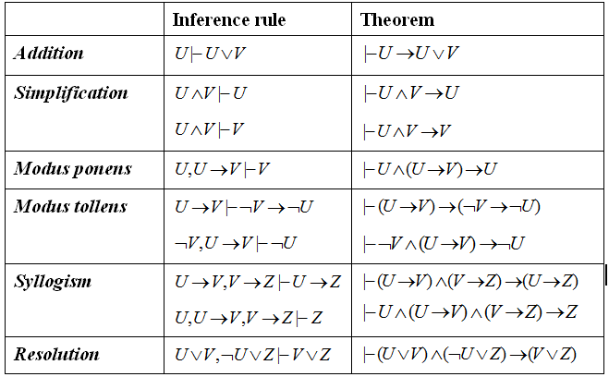
PROPOSITIONAL INFERENCE RULES

Slide 10
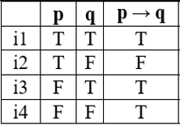

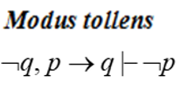
Modus ponens - Latin
“mode that by affirming the premise (p) affirms the conclusion (q)”
Modus tollens - Latin
“mode that by denying the conclusion (q) denies the premise (p)”

Slide 11
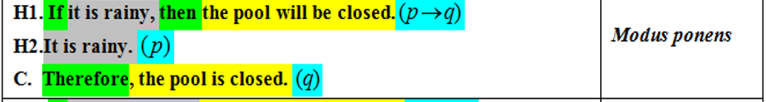
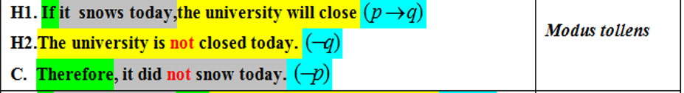
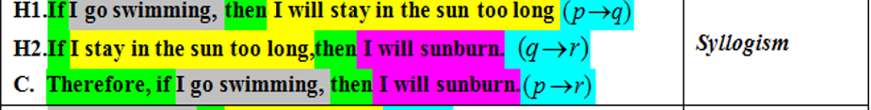
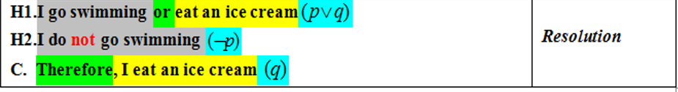
WHICH RULE OF INFERENCE IS USED IN EACH ARGUMENT BELOW?

Slide 12
EXAMPLE 3 OF REASONING MODELING
Build a deduction of the conclusion (C) from the hypotheses H1, H2, H3, H4.
H1: If it is rainy Kate goes to the library or she goes shopping.
H2: Kate goes shopping only with her friend Carla.
H3: John goes to the library daily.
H4: It is rainy today, Carla is sick and she will not go shopping.
C (conclusion) Kate will meet John at the library today.

Slide 13

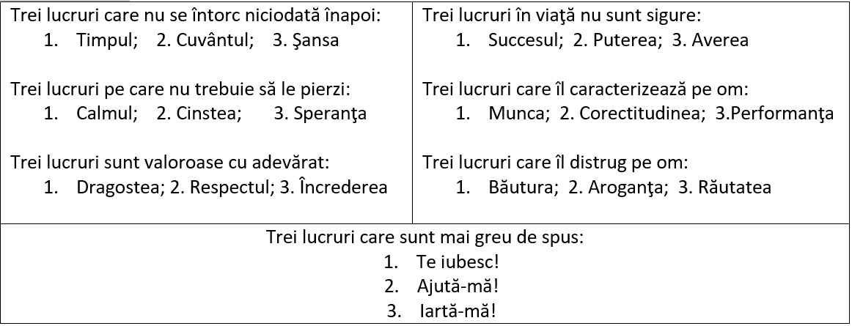
ÎNŢELEPCIUNE

Slide 14
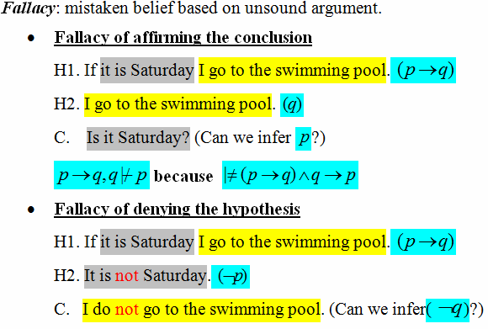
FALLACIES

Slide 15
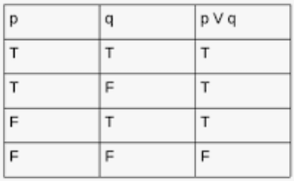
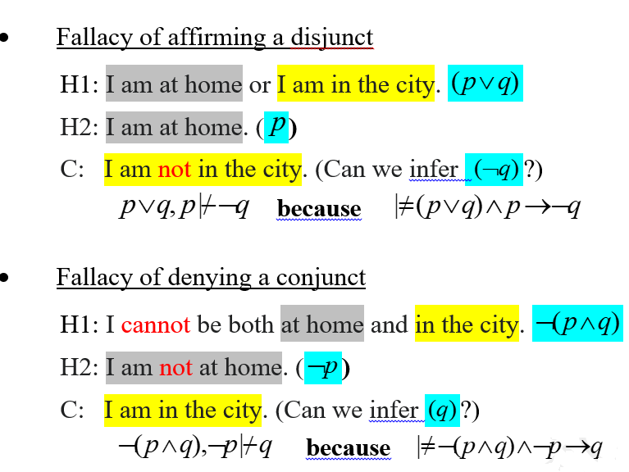
FALLACIES (contd.)

Slide 16
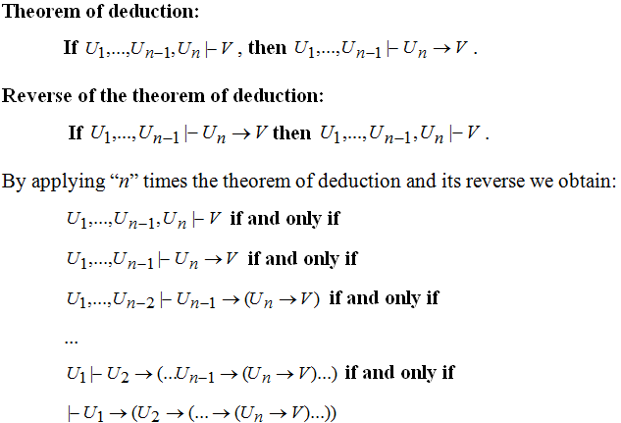
THEOREM OF DEDUCTION AND ITS REVERSE

Slide 17
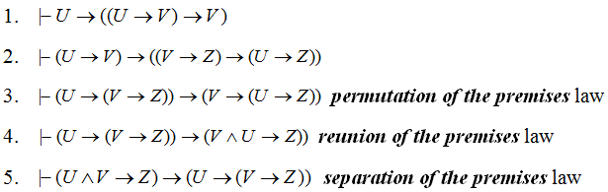
Theorem of deduction - consequences

Slide 18

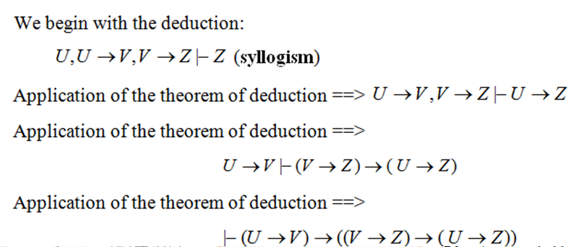
Proof

Slide 19
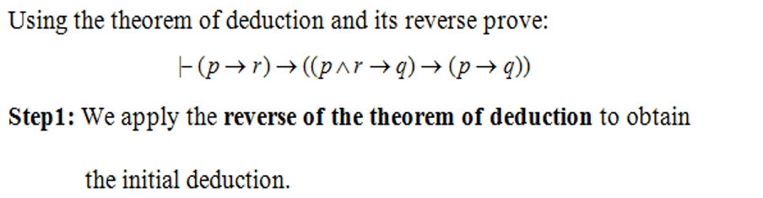
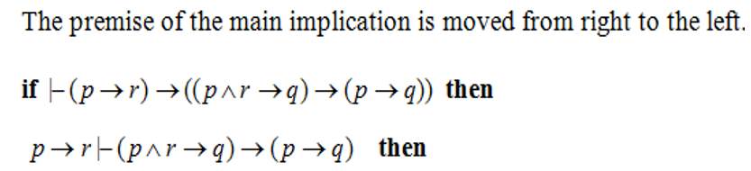

EXAMPLE 4 – THEOREM OF DEDUCTION

Slide 20
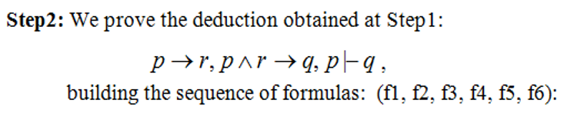





EXAMPLE 4 (CONTD.)

Slide 21
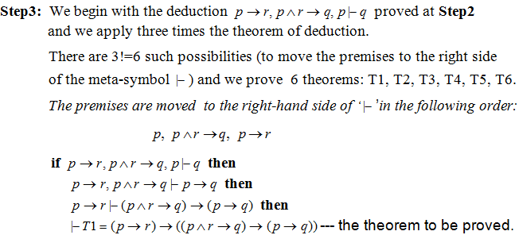
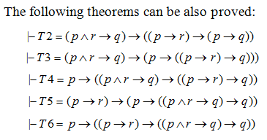
EXAMPLE 4 (CONTD.)

Slide 22
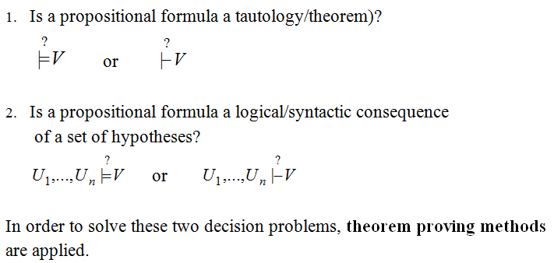
DECISION PROBLEMS IN PROPOSITIONAL LOGIC

Slide 23
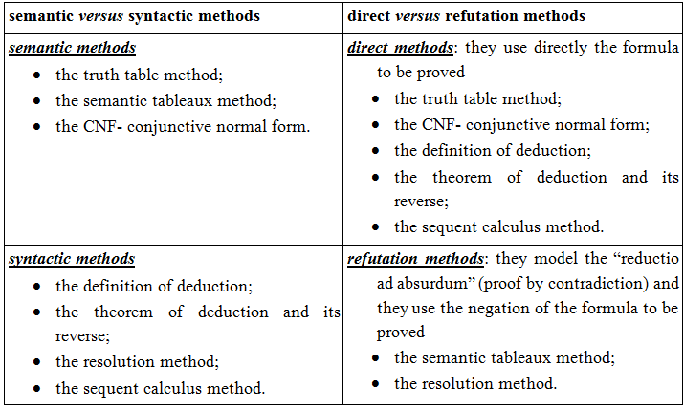
CLASSIFICATION OF PROOF METHODS

